Slide 1
Installation of JBOSS EAP 7.3

Slide 2
Download link for JBOSS EAP 7.3
https://developers.redhat.com/products/eap/download
This needs a Red hat login to be created for downloading the jar.

Slide 3
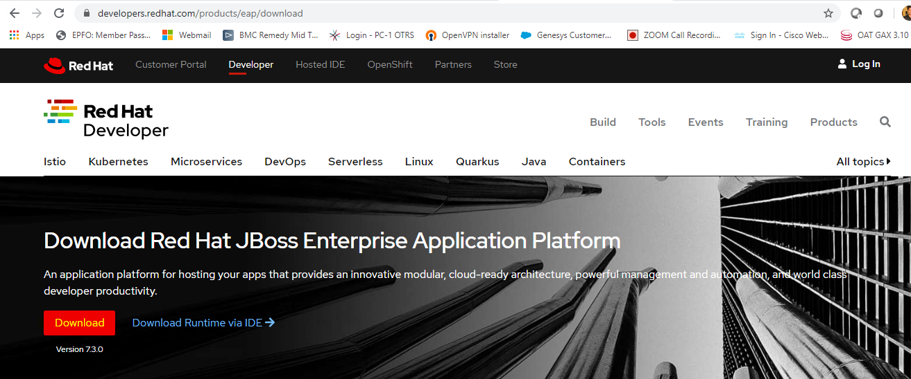

Slide 4
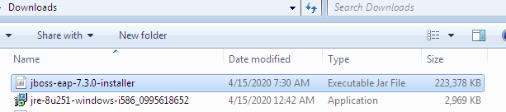
Downloaded JRE and JBOSS EAP 7.3

Slide 5
Installation Pre-requisites
https://access.redhat.com/articles/2026253#EAP_73

Slide 6
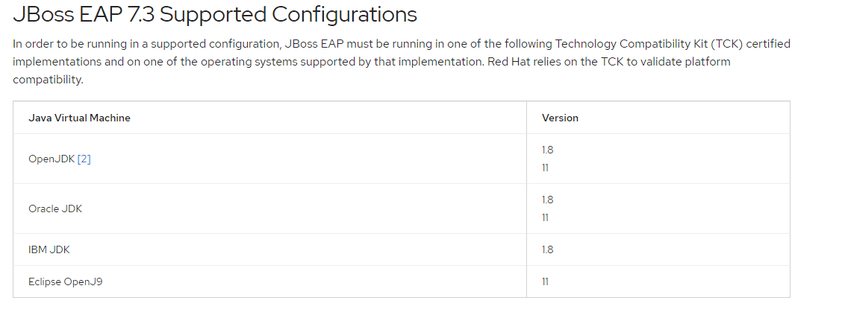

Slide 7
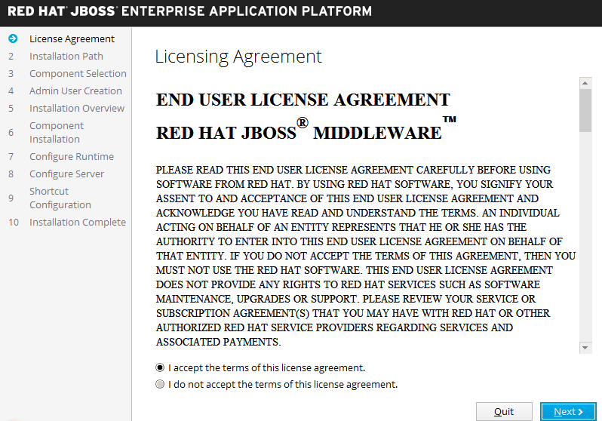

Slide 8
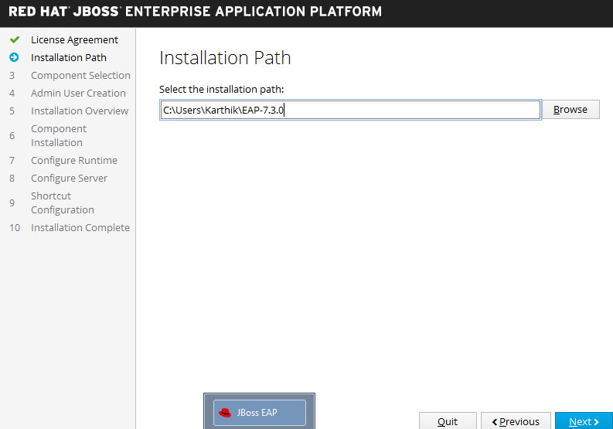

Slide 9
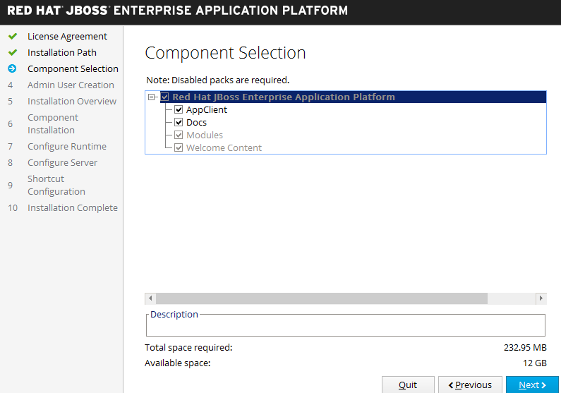

Slide 10
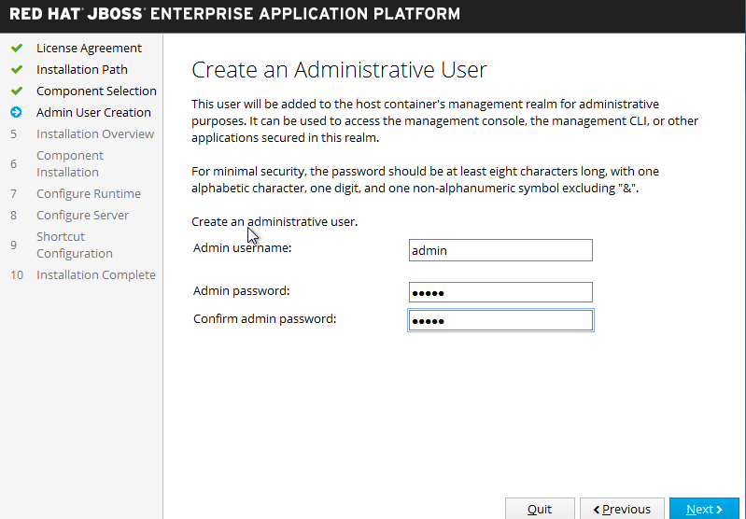
Advisable to give a strong password

Slide 11
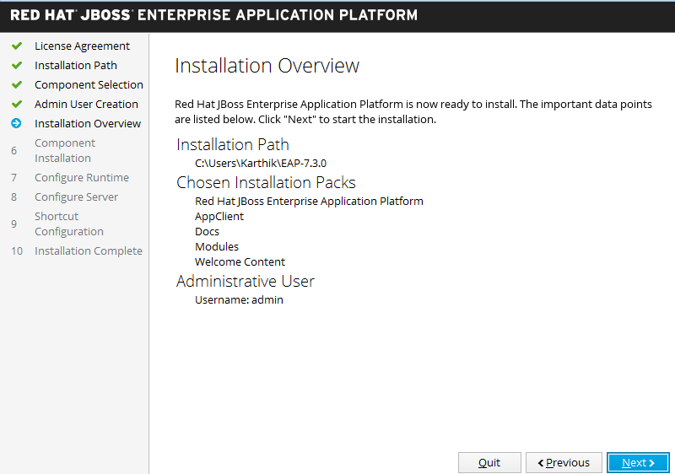

Slide 12
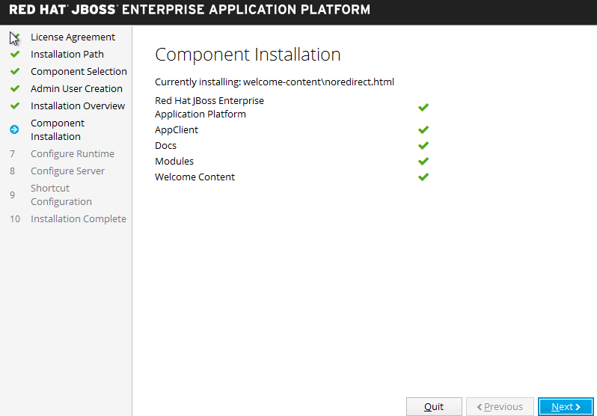

Slide 13
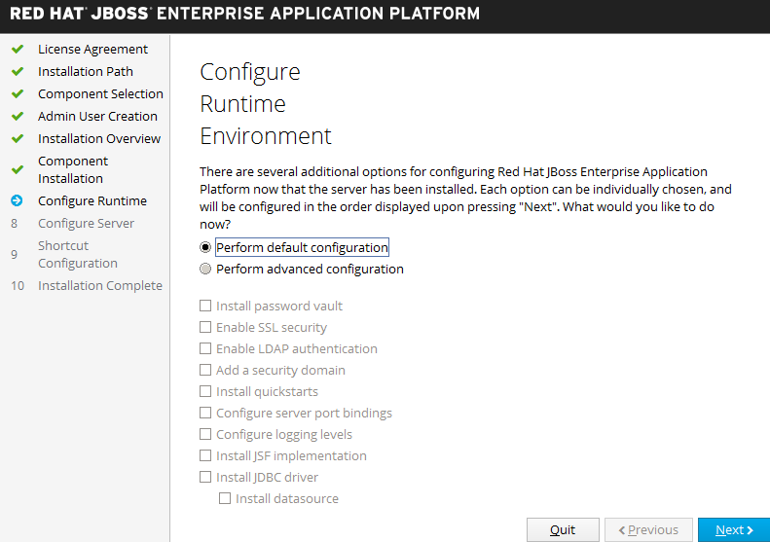

Slide 14
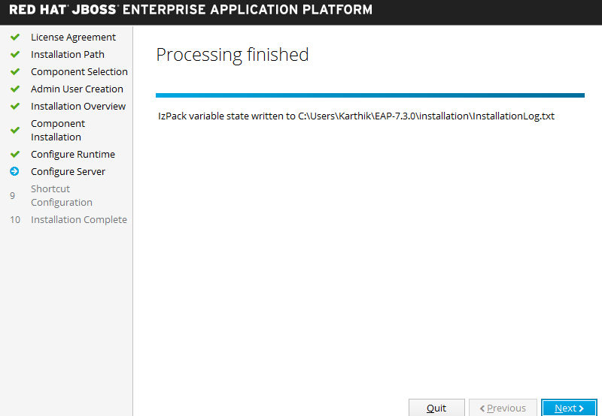

Slide 15
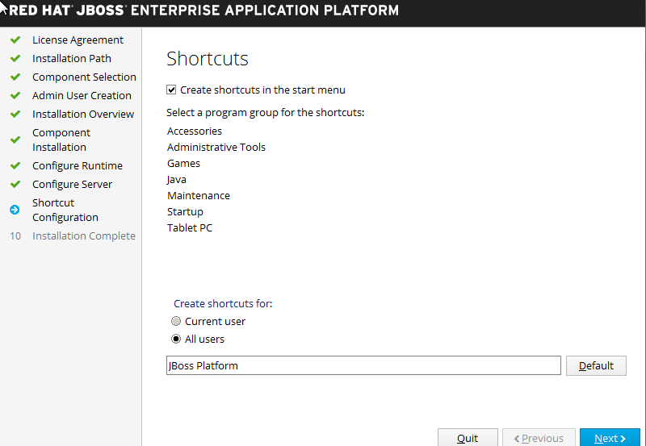

Slide 16
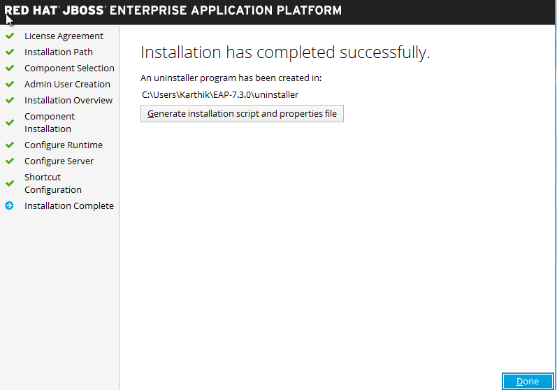

Slide 17
